Slide 1

B. Tech Major Project Evaluation-0, VI Sem Project Title Approval
Lane Detection using the Concept of Deep Learning and Digital Image Processing
Presented by :
SHASHI KANT OJHA (2021310608)
ABHISHEK KUMAR (2021332922)
Under the Supervision of
Ms. Gunjan Aggarwal, Designation: Assistant professor
DEPARTMENT OF COMPUTER SCIENCE & ENGINEERING
SHARDA SCHOOL OF ENGINEERING AND TECHNOLOGY
April, 2024

Slide 2
Agenda
The main goals of lane detection using deep learning and digital image processing are to accurately identify lanes on roads in various conditions, ensure robustness in challenging scenarios, operate in real-time, adapt to different environments, integrate seamlessly with autonomous vehicles/ADAS, provide human interpretable outputs, minimize false positives/negatives, scale efficiently to handle high-resolution data, run on embedded hardware, and continually improve through research and development efforts.

Slide 3
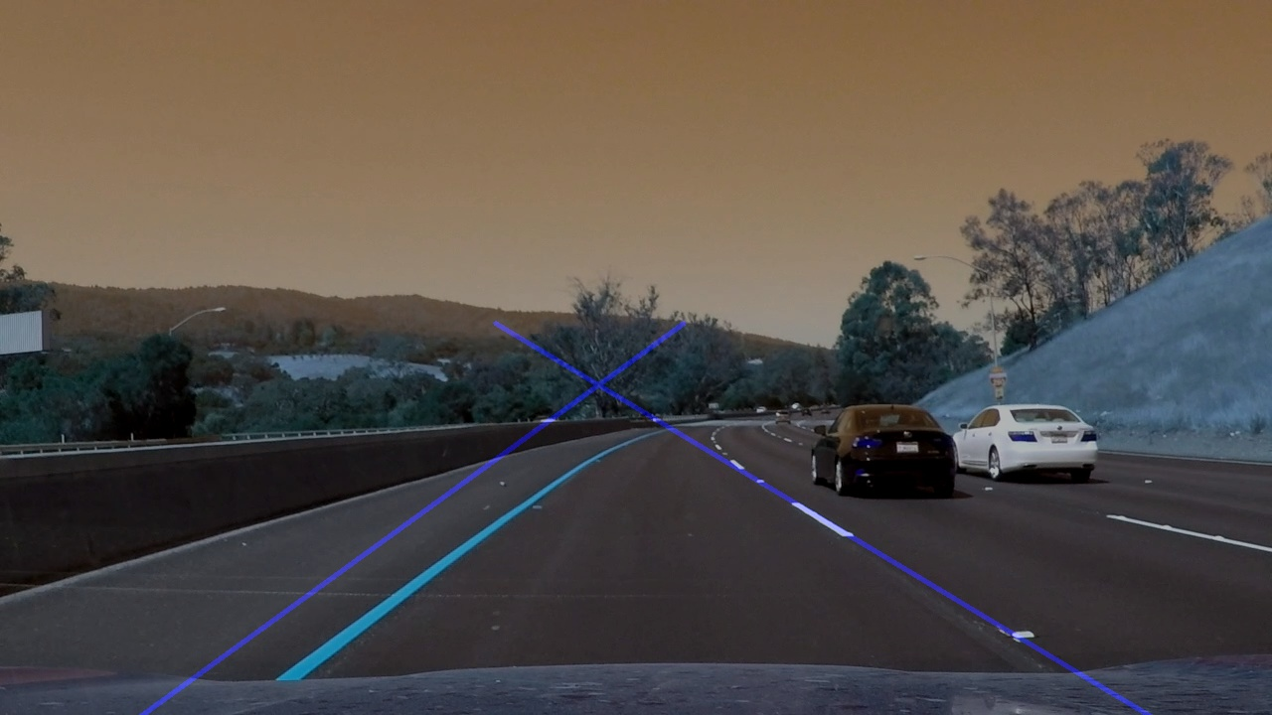
Introduction
Lane detection: Vital process in autonomous driving systems where vehicles identify and follow lane markings on roads.
Importance: Enhances road safety by ensuring vehicles stay within lanes, reducing accidents and improving traffic flow.

Slide 4
Need of Lane Detection System
Traffic safety is becoming crucial as urban traffic grows. People exiting lanes without respecting the laws cause the majority of accidents.
The majority of these are the outcome of the Driver’s interrupted and sluggish behavior.
Computer vision is a form of technology that enables automobiles to comprehend their environment. It’s an artificial intelligence branch that helps software to understand video and image input.
The system’s goal is to find the lane markings if present and if not then generate it’s own to provide a safer environment for the upcoming traffic.

Slide 5
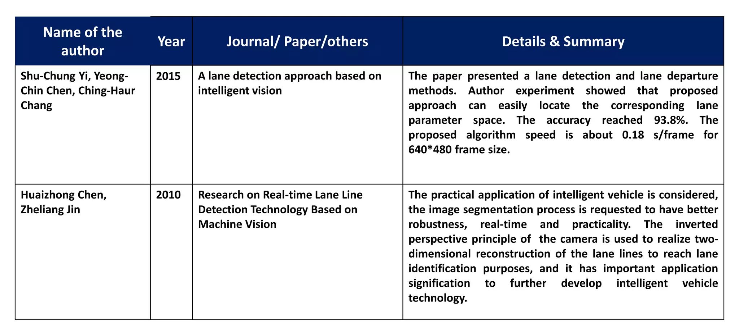
Literature review

Slide 6
Title | Authors | Year | Journal/Conference | Methodology | Drawbacks | Dataset Used
DeepLane: End-to-End Lane Position Estimation Using Deep Learning Techniques | Lee, Seokju, et al. | 2017 | IEEE Intelligent Vehicles Symposium | End-to-end deep learning | Limited generalization to complex scenarios | KITTI dataset
Real-time Lane Detection and Tracking using Deep Neural Networks | Li, C., et al. | 2017 | IEEE Intelligent Vehicles Symposium | Deep neural networks | Sensitivity to noise and occlusions | Caltech Lanes dataset
Robust lane detection from continuous driving scene images using deep neural networks | Li, J., et al. | 2019 | IEEE Transactions on Intelligent Transportation Systems | Deep neural networks with attention mechanisms | Limited scalability to high-resolution images | ApolloScape dataset
Efficient Lane Detection with Deep Learning for Autonomous Vehicles | Zhang, Y., et al. | 2018 | IEEE Transactions on Intelligent Transportation Systems | Lightweight convolutional neural networks | Reduced accuracy in challenging lighting conditions | TuSimple dataset
A Deep Learning Approach to Traffic Scene Understanding | Xiong, W., et al. | 2017 | IEEE Transactions on Intelligent Transportation Systems | Multimodal fusion with deep learning | High computational complexity | Cityscapes dataset

Slide 7
Problem Statement:
Variability in Lane Markings: Address the variability in lane markings including differences in color, width, texture, and degradation over time.
Environmental Conditions: Overcome the effects of varying lighting conditions, weather (e.g., rain, snow), and occlusions (e.g., shadows, other vehicles).
Complex Road Geometries: Detect lanes on roads with complex geometries such as curves, intersections, merges, and abrupt lane changes.
Real-time Performance: Ensure the system operates in real-time to provide timely feedback to autonomous vehicles or driver assistance systems.
Integration: Seamlessly integrate the lane detection system with other components of autonomous vehicles or ADAS to facilitate tasks like lane keeping and lane departure warning.
Minimize False Positives/Negatives: Minimize false positive (detecting a lane where there isn't one) and false negative (failing to detect a lane when it's present) rates to ensure system reliability.
Scalability and Efficiency: Develop algorithms that can handle high-resolution images and video streams while running efficiently on embedded hardware commonly found in vehicles.
Continual Improvement: Pursue ongoing research and development efforts to improve the accuracy, robustness, and efficiency of lane detection systems through advancements in deep learning architectures, data augmentation techniques, and optimization algorithms.

Slide 8
Drawbacks of earlier methods
Limited robustness against variations in lane markings and environmental conditions.
Manual parameter tuning leading to less adaptability.
Difficulty in handling complex scenarios like intersections and lane merges.
Sensitivity to noise and artifacts.
Limited generalization across different road types and driving conditions.
Scalability issues with high-resolution images.
Lack of learning capability for continual improvement.

Slide 9
Objectives:
Develop a deep learning-based lane detection model capable of accurately identifying lane markings under various environmental conditions such as different lighting, weather, and road surfaces.
Design an efficient and computationally lightweight architecture suitable for real-time implementation on embedded systems or in-vehicle processing units.
Enhance the robustness of the lane detection model to handle challenging scenarios including occlusions, curved roads, lane changes, and complex traffic situations.
Evaluate the performance of the developed model on benchmark datasets and in real-world driving scenarios to assess its accuracy, speed, and reliability.

Slide 10
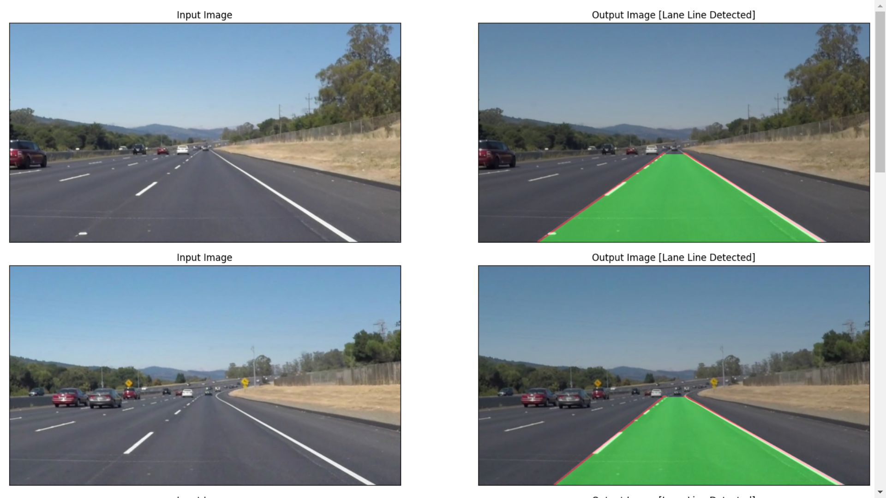
Prototype of the model

Slide 11
Team Size and Project Planning
S. No | Student Name | Roll Number | System ID | Role
1 | Shashi Kant Ojha | 210101450 | 2021310608 | Implementation
2 | Abhishek Kumar | 210101028 | 2021332922 | Design the complete layout structure.

Slide 12
Conclusion
A deep learning-based lane detection model capable of accurately identifying lane markings in real-time.
Robustness to diverse driving conditions, including challenging scenarios like occlusions and lane changes.
Integration with existing autonomous driving or ADAS systems for real-world deployment.
Improved safety and reliability in autonomous vehicles through enhanced lane detection capabilities.
Integration into autonomous vehicles for lane-keeping assistance, lane departure warning systems, and autonomous navigation.

Slide 13
References
[1] Canny, J. (1986). A Computational Approach to Edge Detection. IEEE Transactions on Pattern Analysis and Machine Intelligence, 8(6), 679-698.
[2] Hough, P. V. C. (1962). Method and Means for Recognizing Complex Patterns. U.S. Patent No. 3,069,654.
[3] RANSAC (Random Sample Consensus). (n.d.). Retrieved from https://en.wikipedia.org/wiki/Random_sample_consensus
[4] Long, J., Shelhamer, E., & Darrell, T. (2015). Fully Convolutional Networks for Semantic Segmentation. Proceedings of the IEEE Conference on Computer Vision and Pattern Recognition (CVPR), 3431-3440.
[5] Ronneberger, O., Fischer, P., & Brox, T. (2015). U-Net: Convolutional Networks for Biomedical Image Segmentation. Medical Image Computing and Computer-Assisted Intervention (MICCAI), 9351, 234-241.

Slide 14
[6] Redmon, J., & Farhadi, A. (2017). YOLO9000: Better, Faster, Stronger. Proceedings of the IEEE Conference on Computer Vision and Pattern Recognition (CVPR), 7263-7271. [7] Hochreiter, S., & Schmidhuber, J. (1997). Long Short-Term Memory. Neural Computation, 9(8), 1735-1780. [8] Girshick, R. (2015). Fast R-CNN. Proceedings of the IEEE International Conference on Computer Vision (ICCV), 1440-1448. [9] He, K., Gkioxari, G., Dollár, P., & Girshick, R. (2017). Mask R-CNN. Proceedings of the IEEE International Conference on Computer Vision (ICCV), 2961-2969. [10] Felzenszwalb, P. F., Girshick, R. B., McAllester, D., & Ramanan, D. (2010). Object Detection with Discriminatively Trained Part-Based Models. IEEE Transactions on Pattern Analysis and Machine Intelligence, 32(9), 1627-1645. [11] Ciresan, D., Giusti, A., Gambardella, L. M., & Schmidhuber, J. (2012). Deep Neural Networks Segment Neuronal Membranes in Electron Microscopy Images. Advances in Neural Information Processing Systems (NIPS), 2843-2851. [12] Lee, C. Y., Xie, S., Gallagher, P., Zhang, Z., & Tu, Z. (2015). Deeply-Supervised Nets. Proceedings of the 18th International Conference on Artificial Intelligence and Statistics (AISTATS), 562-570.

Slide 15
THANK YOU

